Slide 1
The Data Team
Jeff Leek
@jtleek
www.jtleek.com

Slide 2
Data science is a team sport

Slide 3
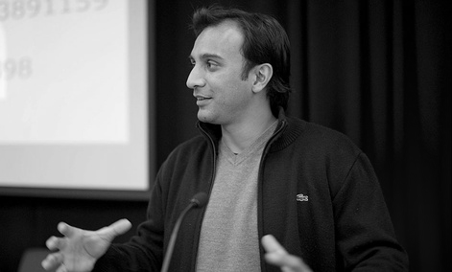
“
Data science
is a team sport
-D.J. Patil
”
Source: http://bit.ly/1eP7ykD

Slide 4
Data engineer
Data architecture
Data infrastructure

Slide 5

http://ww1.prweb.com/prfiles/2012/08/10/9790635/EngineerDataCenter.jpg

Slide 6
Data science
Data cleaning
Data analysis and communication

Slide 7
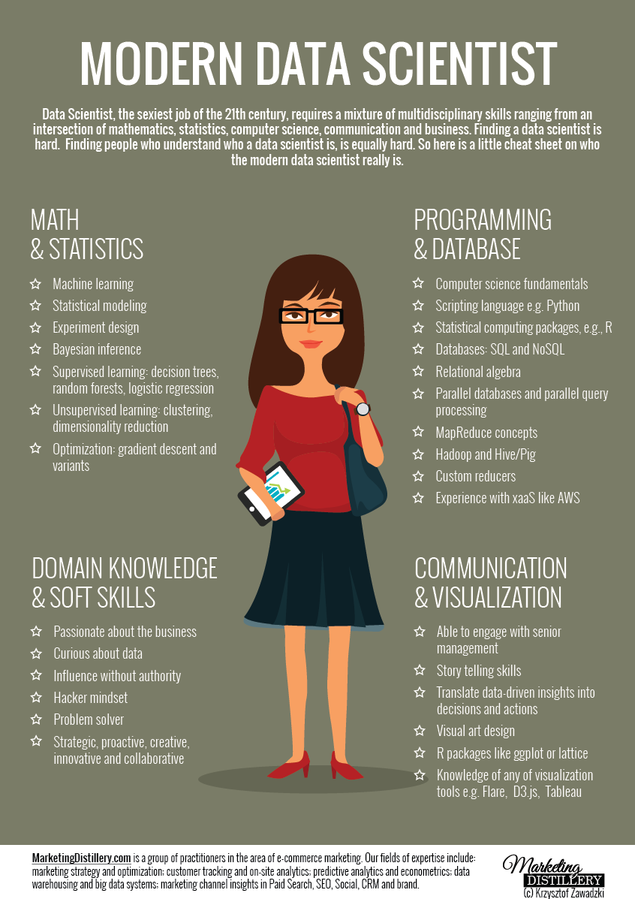
http://www.marketingdistillery.com/2014/11/29/is-data-science-a-buzzword-modern-data-scientist-defined/

Slide 8
Data team management

Slide 9
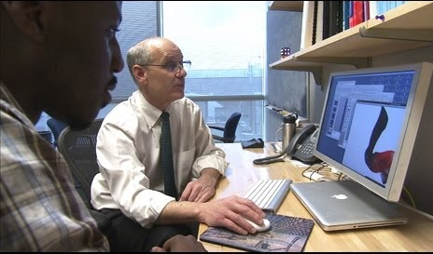
https://rising.jhu.edu/inhealth

Slide 10
How they work together

Slide 11

http://www.datanami.com/2015/07/30/are-you-ready-for-a-data-scientist/

